Slide 1


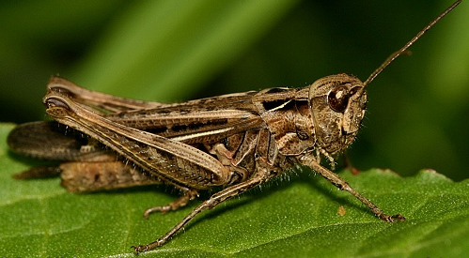
DO NOW
Raise your hand when you are done and I will stamp your tracker.
DO
NOW
1. Make 2 qualitative observations about this picture of rocks:
2. Make 2 qualitative observations about this picture of a grasshopper:

Slide 2
What are we learning today?
Content Objective:
We will explore biotic and abiotic factors.
We will understand how to apply making qualitative observations.
Language Objective:
We will define biotic and abiotic factors.
We will make and discuss qualitative observations or biotic and abiotic factors.

Slide 3
AGENDA
Do Now
Introduction to new material – biotic and abiotic factors
Group work: Practicing with sorting cards
Independent practice
Exit ticket
PRO Points Prizes

Slide 4
AGENDA
Do Now
Introduction to new material – biotic and abiotic factors
Group work: Practicing with sorting cards
Independent practice
Exit ticket
PRO Points Prizes

Slide 5
Let’s think about the Do Now…
Did the rock and the grasshopper have anything in common?
How were they different?

Slide 6
Every thing can be classified as…
Biotic
OR
ABiotic

Slide 7
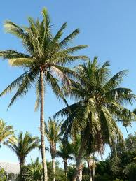
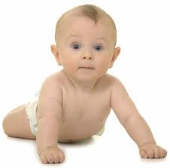
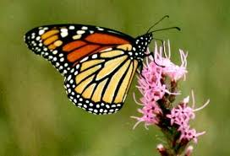
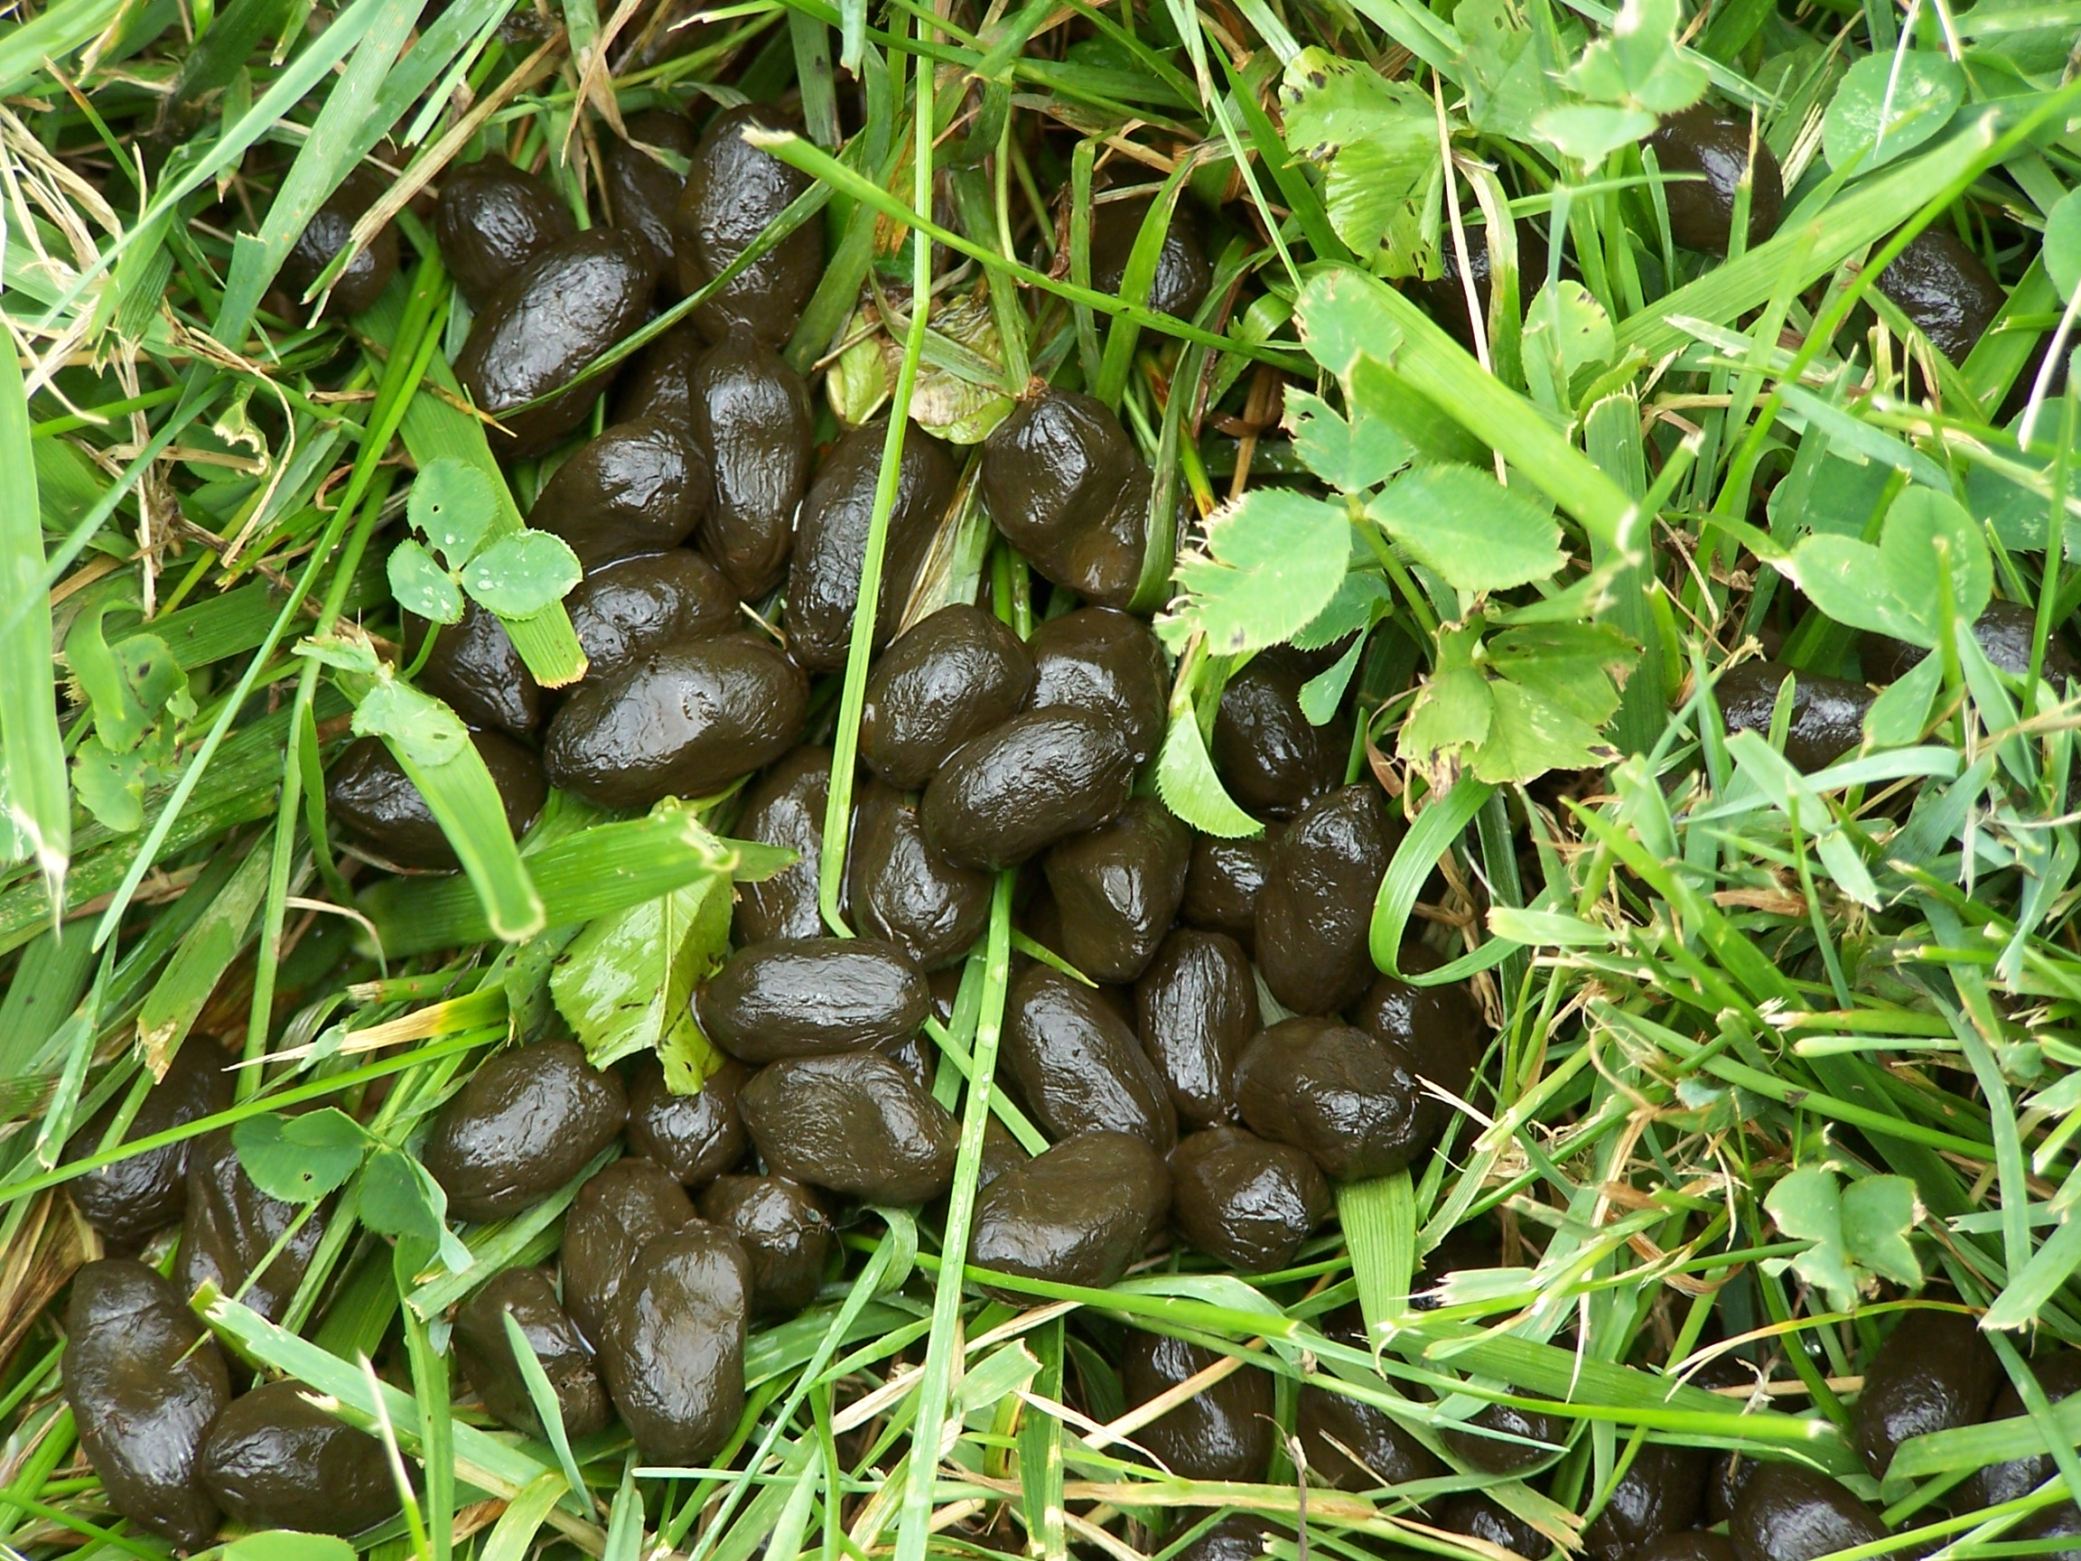
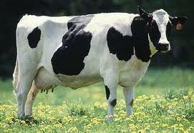
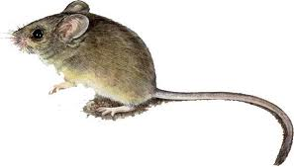
Biotic
Biotic → bio means “life”
Biotic means living things and the products of living things.

Slide 8
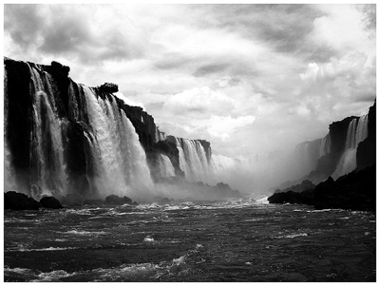
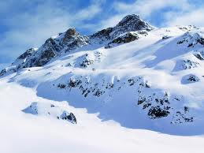

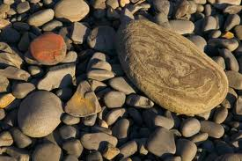
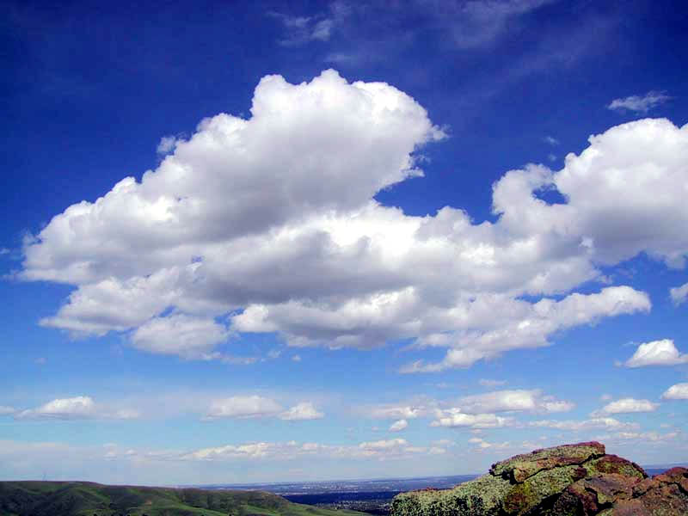

Abiotic
Bio means “life,” and “a” means “not” → not life
Abiotic means nonliving things.

Slide 9
AGENDA
Do Now
Introduction to new material – biotic and abiotic factors
Group work: Practicing with sorting cards
Independent practice
Exit ticket
PRO Points Prizes

Slide 10
Group work: Card Sort (7 minutes)
The Primary Investigator is passing out bins with cards in them
Sort the cards into “biotic” or “abiotic”
Make sure you can explain HOW you know each card is biotic or abiotic

Slide 11
Cards clean up
Stack all the cards neatly
Put them back in the bins
The Primary Investigator is going to collect the bins

Slide 12
AGENDA
Do Now
Introduction to new material – biotic and abiotic factors
Group work: Practicing with sorting cards
Independent practice
Exit ticket
PRO Points Prizes

Slide 13
Now it’s your turn to do it! (3 minutes)
This part of practice is SILENT and INDEPENDENT.
When you are done, put your pencil down so I know you have finished

Slide 14
AGENDA
Do Now
Introduction to new material – biotic and abiotic factors
Group work: Practicing with sorting cards
Independent practice
Exit ticket
PRO Points Prizes

Slide 15
Exit Ticket
The exit ticket is where you get to show me what you know!
Work is SILENT and INDEPENDENT.
When you are done, put your pencil down so I know you are finished.

Slide 16
PRO Points Prizes
Add up Week 2 Pro Points
Remember:
80 points in a week:
- A star on “The PROS of Room 310” board
- A call home to brag!
- Donut or full-size candy bar of your choice
66-79 points in a week:
- Pick something out of the PRO POINTS prize box
51-65 points in a week:
Set up an appointment with Ms. Bonamassa to talk about what you’re missing and what steps we can take
50 points or less:
  A call or email home
  An appointment to talk about what you’re missing and what steps we can take

